Slide 1
Project 2048
Leonie Böhm & Caroline Czapla

Slide 2
Overview
The Vision
The Process
SHOWTIME
Self evaluation

Slide 3
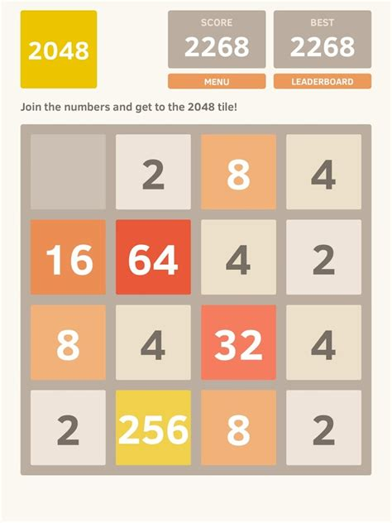
The Vision
https://play.google.com/store/apps/details?id=com.ketchapp.play2048

Slide 4
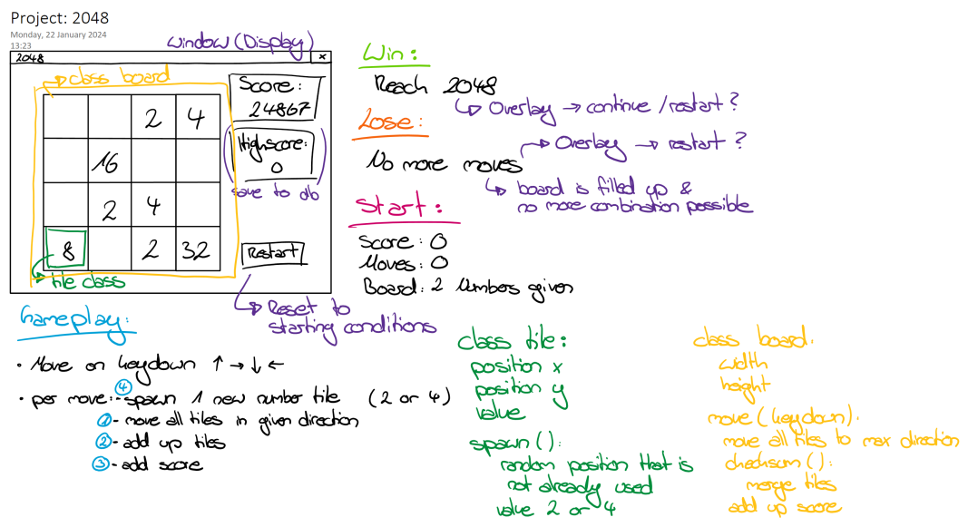
OUr Vision

Slide 5
The process
What was the most fun?
→Working together & learning from each other
What was the most difficult?
→Getting the screen to render the way we wanted it to…
Which function took the longest?
„moveTiles()“ – total 4 hours

Slide 6
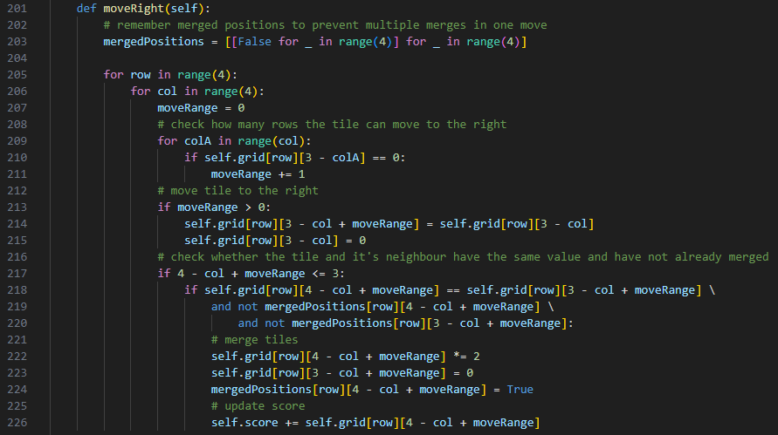

Slide 7
The process
17 Issues
14 closed
3 open
→ 82 % „done“

Slide 8
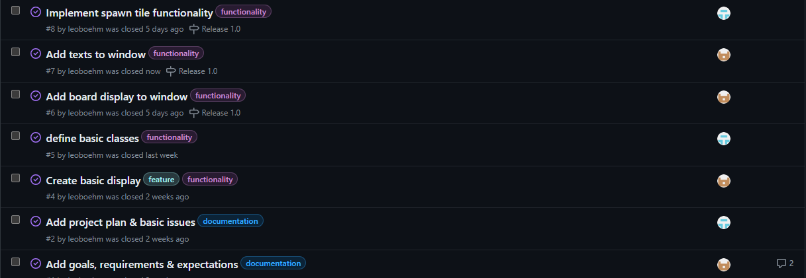

Slide 9
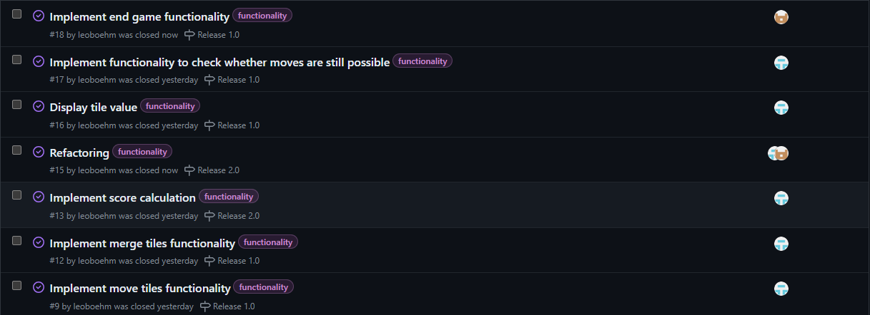

Slide 10
https://github.com/leoboehm/2048

Slide 11
SHOWTIME

Slide 12
Self evaluation
Professional competence
Methodological competence
(Advanced) Python knowledge
Usage of pygame
Usage of different data types
Usage of conditions & loops
Object-oriented programming
Refactoring & code improval
Usage of GIT
Contribution
Repository
Issues
Wiki
Usage of Visual Studio Code

Slide 13
Self evaluation
Personal/Social competence
Action competence
Shared our knowledge & helped each other
Independency & self-reliance:
Learned GitHub functionality
Learned basic pygame usage
Task management/distribution (based on different states of knowledge)
Teamwork
Choosing, planning & executing our own project
Time management (was definitely a problem…)
Troubleshooting & problem-solving skills
Research skills

Slide 14
It takes a lot of hard work to create something simple.
“
”
Steve Jobs

